Slide 1


FINANCIAL RISK MANAGEMENT AND ENGINEERING
Session 3: Value-at-Risk: Parametric, Historical & Monte Carlo
Notes:
Session 3 of 12. Today we master the three canonical VaR methods that form the quantitative spine of Assignment 1.

Slide 2
Learning Objectives
By the end of this session, you will be able to:
1. Define VaR precisely and interpret it in plain language for a non-specialist
2. Implement the three VaR methods: parametric (variance-covariance), historical simulation, and Monte Carlo
3. Apply the square-root-of-time rule and state when it breaks down
4. Decompose portfolio VaR into component, marginal, and incremental contributions
5. Critically evaluate each method's assumptions, strengths, and failure modes
6. Relate VaR to Basel capital requirements and the FRTB transition to Expected Shortfall
Notes:
Six objectives matching four blocks. The first five are assessed directly in Assignment 1 (Sessions 2 to 4). Objective 6 connects to the regulatory framing that runs through the whole course.

Slide 3
What Is Value-at-Risk?
The core question
VaR answers: “What loss level is such that we are X% confident it will not be exceeded in N business days?”
Equivalently, it is the alpha-quantile of the loss (negative P&L) distribution
Reported as a positive number - a dollar loss threshold, not a probability
Conventions and meaning
Standard settings: alpha = 99% (Basel); horizon T = 1 day or 10 days
Example: a 1-day 99% VaR of 1.2M USD means a 1% chance of losing more than 1.2M in one trading day
VaR does NOT tell you how bad the loss is once you exceed it - that is Expected Shortfall (Session 4)
Adopted broadly after J.P. Morgan's RiskMetrics (1994) framework
Notes:
Students often confuse the confidence level with the tail probability. '99% VaR' means a 1% tail. Also note that VaR is NOT sub-additive: VaR(A+B) can exceed VaR(A)+VaR(B).
CLASSROOM EXAMPLE. Line up 100 hypothetical trading days for a $1,000,000 book, sorted worst to best. The 99% 1-day VaR is the loss only 1 day in 100 beats. If one day loses more than $23,000, then VaR99 = $23,000. Say: VaR is a threshold, not a worst case - it says nothing about how bad the 1% gets.

Slide 4
VaR and Regulatory Capital
Regulators have traditionally used VaR to calculate the capital they require banks to keep, but have recently switched to ES for market risks
The market-risk capital has been based on a 10-day VaR estimated where the confidence level is 99%
Credit risk and operational risk capital are based on a one-year 99.9% VaR
Notes:
Six objectives matching four blocks. The first five are assessed directly in Assignment 1 (Sessions 2 to 4). Objective 6 connects to the regulatory framing that runs through the whole course.

Slide 5
VaR: Key Properties and Caveats
Why VaR is useful
A single number, easy to communicate to senior management
Consistent across asset classes and business units; directly linked to Basel II/III capital
Facilitates limit-setting and position sizing; backtestable against realised exceedances
Scalable: 1-day VaR to 10-day VaR via the sqrt(10) rule
Why VaR can mislead
Ignores the severity of losses beyond the threshold
Not sub-additive, so it can penalise diversification; parametric VaR underestimates fat-tailed losses
Historical VaR is backward-looking and silent on unseen crises
Manipulable: positions can be gamed near quarter-end; Beder (1995): '14 ways to compute VaR, 14 answers'
Notes:
The second group foreshadows Session 4 (ES) and the key critique in Beder (1995). Beder showed the same portfolio computed with different methods gave a 14-fold range in VaR - a powerful motivator to understand ALL three methods, not just one.

Slide 6
VaR Example
The gain from a portfolio during six month is normally distributed with mean $2 million and standard deviation $10 million
The 1% point of the distribution of gains is 2-2.33×10 or -$21.3 million
The VaR for the portfolio with a six month time horizon and a 99% confidence level is $21.3 million.

Slide 7
VaR Example 2
A one-year project has a 98% chance of leading to a gain of $2 million, a 1.5% chance of a loss of $4 million, and a 0.5% chance of a loss of $10 million
The VaR with a 99% confidence level is $4 million
What if the confidence level is 99.9%?
What if it is 99.5%?

Slide 8
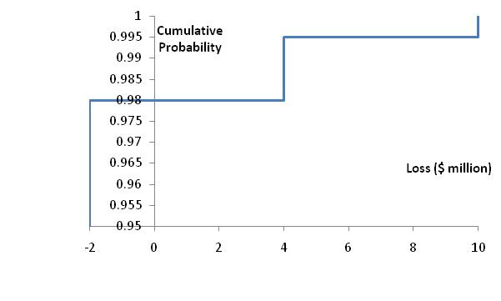
VaR Example 2 Cumulative Loss Distribution

Slide 9
VaR vs. Expected Shortfall
VaR is the loss level that will not be exceeded with a specified probability
Expected shortfall (ES) is the expected loss given that the loss is greater than the VaR level (also called C-VaR and Tail Loss)
Regulators have moved from using VaR to using ES for determining market risk capital
Two portfolios with the same VaR can have very different expected shortfalls

Slide 10
Distributions with the Same VaR but Different Expected Shortfalls
VaR
VaR

Slide 11
Coherent Risk Measures
Define a coherent risk measure as the amount of cash that has to be added to a portfolio to make its risk acceptable
Properties of coherent risk measure
  If one portfolio always produces a worse outcome than another its risk measure should be greater
  If we add an amount of cash K to a portfolio its risk measure should go down by K
  Changing the size of a portfolio by λ should result in the risk measure being multiplied by λ
  The risk measures for two portfolios after they have been merged should be no greater than the sum of their risk measures before they were merged
  VaR satisfies the first three conditions but not the fourth one. ES satisfies all four conditions.

Slide 12
Normal Distribution Assumption
When losses (gains) are normally distributed with mean μ and standard deviation σ
Notes:
CLASSROOM EXAMPLE. A $1,000,000 book, daily returns assumed normal with mean m = 0 and s = 1%. The normal model gives VaR just by scaling s by z: 95% -> 1.645 x 0.01 x 1,000,000 = $16,450; 99% -> 2.33 x 0.01 x 1,000,000 = $23,300; 99.9% -> 3.09 x 0.01 x 1,000,000 = $30,900. The convenience: you only need m and s, nothing else. The cost is thin tails - the normal says a -5% day (5 sigma, a $50,000 loss) happens about once in 14,000 years, yet the S&P 500 has delivered several 5-sigma-plus days in recent decades (Black Monday 1987 was about -20 sigma). Say: that gap is fat tails - real losses cluster far beyond the bell curve, so normal VaR systematically understates the 99%-plus tail, which is exactly why we also teach historical simulation, Student-t, and EVT.

Slide 13
Normal Distribution VaR: Example
Assumptions: returns normal, mu = 0.05% and sigma = 2% (daily), V = $1,000,000, c = 99%
z = 2.326 (the 99% standard-normal quantile)
VaR (loss) = (z*sigma - mu) * V
VaR = (2.326 x 0.02 - 0.0005) x 1,000,000 = (0.04652 - 0.0005) x 1,000,000 = $46,020
ES (loss) = (sigma * phi(z)/(1 - c) - mu) * V, phi(z)/(1 - c) = 0.02665/0.01 = 2.665
ES = (0.02 x 2.665 - 0.0005) x 1,000,000 = (0.05330 - 0.0005) x 1,000,000 = $52,800
Notes:
CLASSROOM EXAMPLE. A $1,000,000 book, daily returns assumed normal with mean m = 0 and s = 1%. The normal model gives VaR just by scaling s by z: 95% -> 1.645 x 0.01 x 1,000,000 = $16,450; 99% -> 2.33 x 0.01 x 1,000,000 = $23,300; 99.9% -> 3.09 x 0.01 x 1,000,000 = $30,900. The convenience: you only need m and s, nothing else. The cost is thin tails - the normal says a -5% day (5 sigma, a $50,000 loss) happens about once in 14,000 years, yet the S&P 500 has delivered several 5-sigma-plus days in recent decades (Black Monday 1987 was about -20 sigma). Say: that gap is fat tails - real losses cluster far beyond the bell curve, so normal VaR systematically understates the 99%-plus tail, which is exactly why we also teach historical simulation, Student-t, and EVT.

Slide 14
Multi-Horizon VaR - the Square-Root-of-Time Rule
The rule
Under i.i.d. daily returns, variance scales with h, so the standard deviation scales with sqrt(h)
Basel application: 10-day VaR = 1-day VaR x sqrt(10), about 3.162x
When it breaks
Breaks down when returns are autocorrelated or GARCH; volatility clustering makes empirical VaR grow slower than sqrt(h)
Lab finding: sqrt(T) overstates VaR at long horizons because mean-reverting volatility dampens h-day risk
At a 1-year horizon, sqrt(252) overstates risk by 20 to 40% in equity data; EVT corrects the very long tail
Notes:
The lab produces a chart comparing sqrt(T) VaR vs empirical HS VaR for horizons 1d to 252d. Students should observe the divergence. This motivates GARCH models (Session 2) and long-horizon stress tests.
CLASSROOM EXAMPLE. 1-day VaR = $46,600. 10-day VaR = 46,600 x sqrt(10) = 46,600 x 3.162 = $147,400. Say: we scale by sqrt(10), not 10, because independent daily variances add. This is the old Basel 10-day charge; it breaks when returns are autocorrelated or volatility clusters.

Slide 15
Changing the Time Horizon
If losses in successive days are independent, normally distributed, and have a mean of zero

Slide 16
Changing the Time Horizon:Example
Assumptions:
iid, normal, mean 0, daily s = 1%, $1,000,000 position, 99%
Both VaR and ES scale by sqrt(T):
1 day (T = 1) VaR $23,300 ES $26,650
1 week (T = 5) VaR $52,100 ES $59,600
1 year (T = 252) VaR $369,900 ES $423,100
Takeaways:
- Risk grows with sqrt(T): 1 year is about 15.9x a 1-day, not 252x
- ES stays about 14% above VaR at every horizon (both scale the same way)

Slide 17
Choice of VaR Parameters
Time horizon should depend on how quickly portfolio can be unwound. Regulators are planning to move toward a system where ES is used and the time horizon depends on liquidity.
Confidence level depends on objectives. Regulators have used 99% for market risk and 99.9% for credit/operational risk.
A bank wanting to maintain a AA credit rating might use confidence levels as high as 99.97% for internal calculations.

Slide 18
Aggregating VaRs
  An approximate approach that seems to works well is
  where VaR_{i} is the VaR for the ith segment, VaR_{total} is the total VaR, and ρ_{ij} is the coefficient of correlation between losses from the ith and jth segments
Notes:
Two segments: VaR_1 = $10m, VaR_2 = $8m
VaR_total = sqrt( VaR_1^2 + VaR_2^2 + 2*rho*VaR_1*VaR_2 )
rho = 0.0 (independent): sqrt(100 + 64 + 0) = sqrt(164) = $12.81m
rho = 0.3 (typical): sqrt(100 + 64 + 48) = sqrt(212) = $14.56m
rho = 1.0 (perfect): sqrt(100 + 64 + 160) = sqrt(324) = $18.00m

Slide 19
VaR Measures for a Portfolio where an amount x_{i} is invested in the ith component of the portfolio
Marginal VaR:
Incremental VaR: Incremental effect of the ith component on VaR
Component VaR:
Notes:
CLASSROOM EXAMPLE. One portfolio worked through all three measures at 99% 1-day (z = 2.326).
Setup:
Component A invests x_A = $6.0m at daily vol 2% -> dollar vol $120k;
Component B invests x_B = $4.0m at daily vol 3% -> dollar vol $120k;
Correlation rho = 0.5; total V = $10m.
Portfolio dollar vol: sigma_p = sqrt(120^2 + 120^2 + 2 x 0.5 x 120 x 120) = sqrt(43,200) = $207.85k (in $000).
Total VaR = 2.326 x 207.85 = $483,500. Each leg's covariance with the book: Cov(A,P) = Var(A) + Cov(A,B) = 14,400 + 7,200 = 21,600; Cov(B,P) = 21,600 (equal by symmetry).
1) MARGINAL VaR (risk of the next dollar) = z x Cov(i,P)/sigma_p, per $1 in leg i. A = 0.0403 (4.0%), B = 0.0604 (6.0%). Say: a $100k top-up to B raises VaR by about $6,040, the same top-up to A only $4,030 - B is the costlier place to add risk.
2) COMPONENT VaR (each leg's share of today's risk) = x_i x Marginal VaR_i.
Component A = $241,700;
Component B = $241,700;
Sum = $483,400 = total VaR (checks). Say: the legs contribute equally even though A is 60% and B is 40% - B's higher per-dollar vol offsets its smaller size. Component VaRs SUM to the total, which is why they are used for risk budgeting and capital allocation (Euler's theorem).
3) INCREMENTAL VaR (effect of a whole position) = VaR(with i) - VaR(without i). VaR of A alone = 2.326 x 120k = $279,100, so Incremental VaR of B = 483,500 - 279,100 = $204,400 (and Incremental A = $204,400 by symmetry). Say: dropping B entirely cuts VaR by $204,400 - LESS than its component VaR of $241,700 - and the two incrementals ($408,800) do NOT sum to the total. That gap is the discrete diversification lost only when a whole leg is removed.
SUMMARY (per $1 marginal):
A: invest $6.0m, $vol $120k, Marginal 0.0403, Component $241,700, Incremental $204,400
B: invest $4.0m, $vol $120k, Marginal 0.0604, Component $241,700, Incremental $204,400
Total: $10.0m, $vol $207.85k, VaR $483,400
Marginal = next dollar (trade sizing, limits);
Component = each leg's share, sums to total VaR (risk budgeting);
Incremental = whole position added or removed, does NOT sum to total.

Slide 20
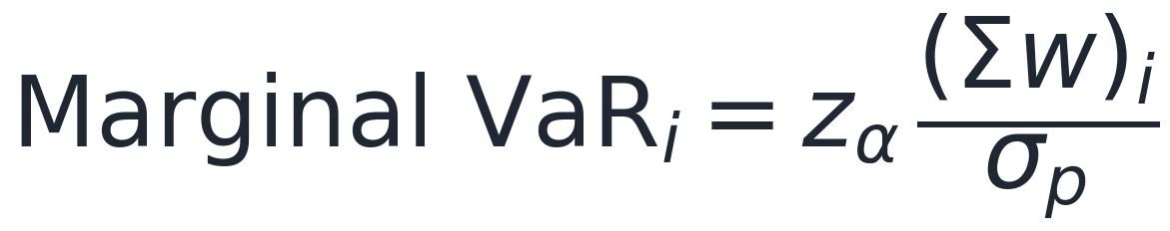
Component, Marginal and Incremental VaR
The three risk-attribution measures
Marginal VaR: the sensitivity of portfolio VaR to asset i's weight (the partial derivative)
Component VaR: how much asset i contributes to total VaR; the components sum exactly to portfolio VaR - no residual
Incremental VaR: VaR(portfolio) minus VaR(portfolio without i); approximately the component VaR for small positions
Using it
Percent contribution = component_i / portfolio VaR; the lab shows SPY drives about 60% of component VaR despite a 40% weight
Risk attribution for limit-setting and hedging decisions
Diversification benefit = sum of standalone VaRs minus portfolio VaR
Notes:
The lab computes this decomposition exactly. SPY's equity risk dominates even though it is a 40% weight, because its vol and correlation with the rest of the portfolio are highest. TLT and AGG provide diversification (bonds negatively correlated with equities in normal regimes).
CLASSROOM EXAMPLE. Same two-asset book: sigma_p = 2.08%, z = 2.33, Sigma*w = (0.00036, 0.00054). Marginal VaR1 = 2.33 x 0.00036 / 0.0208 = 4.03%; Marginal VaR2 = 2.33 x 0.00054 / 0.0208 = 6.05%. Component VaR1 = 0.6 x 0.0403 x 1,000,000 = $24,200; Component VaR2 = 0.4 x 0.0605 x 1,000,000 = $24,200; sum = $48,400 = total VaR. Say: the 40% position carries as much risk as the 60% one because it is more volatile - weight is not risk, and the components add up exactly.

Slide 21
Back-testing
Back-testing a VaR calculation methodology involves looking at how often exceptions (loss > VaR) occur
Alternatives: a) compare VaR with actual change in portfolio value and b) compare VaR with change in portfolio value assuming no change in portfolio composition
Suppose that the theoretical probability of an exception is p (=1−X). The probability of m or more exceptions in n days is
Notes:
Setup
99% 1-day VaR -> p = 1 - X = 0.01 (an exception should occur 1% of days)
n = 250 trading days (one year)
Expected exceptions = n x p = 250 x 0.01 = 2.5
Observed exceptions = 8 (loss exceeded VaR on 8 days)
1. Is 8 too many? (the slide's binomial tail)
Probability of m or more exceptions when the model is correct:
P(X >= m) = sum_{k=m}^{n} C(n,k) p^k (1-p)^(n-k), X ~ Binomial(250, 0.01)
With mean 2.5 this is well-approximated by Poisson(2.5):
P(X >= 8) = 1 - P(X <= 7) = 1 - 0.9957 = 0.0043 (about 0.4%)
If the VaR model were accurate, 8-or-more exceptions in a year would happen only ~0.4% of the time. That is strong evidence the model understates risk.
2. Kupiec POF test (proportion of failures, formal version)
LR_POF = -2 ln [ (1-p)^(n-m) p^m / ( (1 - m/n)^(n-m) (m/n)^m ) ] ~ chi-square(1)
observed failure rate = m/n = 8/250 = 3.2% (vs the 1.0% the model claims)
LR_POF = 7.73
Critical values: chi-square(1) = 3.84 at 95%, 6.63 at 99%. Since 7.73 > 6.63, reject the model even at the 99% level. The observed 3.2% breach rate is statistically inconsistent with a true 1%.
3. Basel traffic light (n = 250, 99% VaR)
Green zone: 0 - 4 exceptions -> multiplier stays 3.00 (model accepted)
Yellow zone: 5 - 9 exceptions -> multiplier rises 3.4
Red zone: 10+ exceptions -> multiplier 4.00, model rejected
Our 8 exceptions land in the yellow zone: the capital muy 3.65), and the bank must explain the breaches. The regulator does not just fail you or pass you - it scales your capital penalty to how badly the model missed.
The three sentences to leave them with
- Count exceptions and compare to the expected n x p - here 8 versus 2.5.
- The binomial (Kupiec) test says whether that gap is bare p-value ~0.4%, LR = 7.73, so the model is rejected.
- Basel turns the count into money: green keeps the 3x multiplier, yellow raises it, red forces a rebuild.

Slide 22
Case Study: How VaR Fails in a Crisis (LTCM 1998)
What happened
LTCM's parametric VaR assumed stable correlations across markets; leverage about 25:1, notional over 1 trillion USD
August 1998: Russian default triggered a global flight to quality
Correlations spiked toward 1.0 and diversification vanished overnight
The historical lookback window missed the 1998 regime; Monte Carlo used pre-crisis calibration
Loss: about 4.6 billion USD in under four months - VaR badly underestimated tail risk
Key lessons
Parametric VaR: historical covariance breaks in crises
Historical VaR: the window must cover a full stress cycle
Monte Carlo VaR: the simulated distribution reflects the calibration period only
Leverage amplifies every VaR mis-estimation; all methods share the 'history repeats' assumption
See Hull Ch.12 on Extreme Value Theory for heavy-tail corrections
Notes:
LTCM is the single best VaR failure case. Ask students: which method would have been most accurate? Answer: none - the regime shift invalidated all of them. That is the real lesson: use VaR alongside stress tests.

Slide 23
Block 2: The Three VaR Methods
Parametric - Historical Simulation - Monte Carlo
Three routes to the same quantile, each with different assumptions and failure modes
The discipline: report all three and treat their disagreement as a model-risk signal
Notes:
Block 2: 60 minutes. Present each method as a formula plus a worked example. Students implement all three in the Python lab.

Slide 24
Parametric (Variance-Covariance) VaR
The delta-normal method
Assumes returns are jointly normally distributed; needs only the mean mu and covariance Sigma - fast to compute
z_alpha is the inverse normal CDF: 1.645 (95%), 2.054 (98%), 2.326 (99%)
Portfolio variance is w-transpose Sigma w; scale to horizon h with the sqrt(h) rule
Strengths and limits
Hull Ch.13 (model-building approach); Jorion Ch.12 calls it the delta-normal method
Fails for fat tails, options, and nonlinear payoffs
The sqrt(h) scaling assumes i.i.d. returns - often violated by volatility clustering
Notes:
z_alpha is just the inverse normal CDF: scipy.stats.norm.ppf(0.99) = 2.3263. The multi-asset case needs the full covariance matrix: rets.cov().
CLASSROOM EXAMPLE. Single asset: V = $1,000,000, daily mu = 0, sigma = 2%, z(99%) = 2.33. VaR = 2.33 x 0.02 x 1,000,000 = $46,600 (at 95%, z = 1.645 -> $32,900). Two assets for sigma_p: w = (0.6, 0.4), sigma1 = 2%, sigma2 = 3%, rho = 0.5. sigma_p^2 = 0.000144 + 0.000144 + 0.000144 = 0.000432 -> sigma_p = 2.08%; VaR99 = 2.33 x 0.0208 x 1,000,000 = $48,400. Say: all three variance terms are equal - the cross (correlation) term matters as much as each asset alone.

Slide 25
Parametric VaR - Worked Example
Given (5-asset equal-weight portfolio, 1M USD, 99%)
Portfolio: SPY 40%, TLT 20%, GLD 10%, EFA 20%, AGG 10%; value V = 1,000,000 USD
Data: 2014 to 2024 daily log returns (2,766 observations); confidence alpha = 99%, so z = 2.3263
Estimated: mu_p = 0.019% per day and sigma_p = 0.490% per day (from w-transpose Sigma w)
Solution
Step 1: sigma_p = sqrt(w-transpose Sigma w) = 0.4895% daily
Step 2: z_99% = norm.ppf(0.99) = 2.3263
Step 3: VaR = -(mu + z sigma) V = -(0.00019 + 2.3263 x 0.004895) x 1,000,000, about 11,197 USD
Step 4: 10-day VaR = 11,197 x sqrt(10), about 35,404 USD
Answer: 1-day 99% parametric VaR is about 11,197 USD (1.12% of the portfolio)
Notes:
This is the exact output from Session_03_Lab.ipynb cell 2. Walk the computation live. Ask: what does the covariance matrix add versus computing each asset's VaR independently? Answer: the diversification benefit.

Slide 26
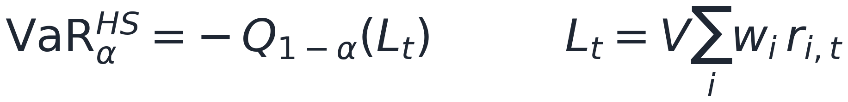
Historical Simulation (HS) VaR
The algorithm
Collect T historical return observations and compute portfolio P&L for each day
Sort ascending and pick the (1 - alpha) x T -th worst outcome; that loss is the HS VaR
HS VaR is minus the empirical (1 - alpha)-quantile of the historical P&L series
Strengths and design choices
No distributional assumption - uses the empirical CDF and captures fat tails already in history
Hull Ch.12 §12.1; in numpy: np.percentile(pnl, 1) for 99% VaR
Window choice is critical: too short is noisy, too long is stale
Variants: Boudoukh (1998) age-weighting; filtered HS (GARCH-HS); silent on crises not in the window
Notes:
HS is the most widely used method in practice - BIS surveys confirm this. Hull Ch.12 goes through the historical simulation approach. The window-length choice is the key design decision.
CLASSROOM EXAMPLE. Take the last 250 days, apply each day's returns to a $2,000,000 book to get 250 hypothetical P&Ls, and sort. The 1% tail of 250 is about 2.5 days, so VaR99 is roughly the 3rd-worst day. If that P&L is -$61,000, VaR99 = $61,000. Say: no sigma, no bell curve - we relive the last year and read off the loss only two or three days beat.

Slide 27
Historical Simulation - Strengths and Weaknesses
Strengths
Non-parametric: no distribution assumption; captures empirical fat tails, skewness and kurtosis
Handles any asset type including options; easy to explain to non-quants
Naturally captures cross-asset correlations; widely accepted by regulators (Basel II internal models)
Weaknesses
Purely backward-looking: cannot see unseen crises
Highly sensitive to window length (250d vs 1000d); gives equal weight to all past observations
Quiet periods produce a tight VaR and false security; does not extrapolate beyond the observed tail
Beder (1995): the choice of window alone can double the VaR estimate
Notes:
Age-weighting (Boudoukh, Richardson, Whitelaw 1998) addresses the equal-weight problem. Filtered HS (Barone-Adesi et al. 1999) applies GARCH-standardised residuals before sorting - best of both worlds.

Slide 28
Monte Carlo (MC) VaR
The procedure
Specify a return process r ~ f(mu, Sigma): multivariate normal, Student-t, or GBM
Simulate N scenarios, compute portfolio P&L for each, then take the (1 - alpha)-quantile
Calibrate mu and Sigma from historical data; the lab uses N = 200,000 for stability
Strengths and limits
Most flexible: any distribution and nonlinear payoffs; Hull Ch.12 §12.4
In numpy: np.random.multivariate_normal(mu, Sigma, N)
Convergence: standard error falls with sqrt(N); weakness is model risk - garbage in, garbage out
Notes:
MC is the most powerful method but also the most model-dependent. With 200,000 simulations the standard error is about 25 USD on an 11,000 USD VaR - more than adequate. For options, replace the MVN draw with a GBM path simulation.
CLASSROOM EXAMPLE. Draw 10,000 random daily returns from N(0, 0.02^2), convert each to a P&L on the $1,000,000 book, sort, and take the 100th-worst (the 1% point). With normal draws it converges to the parametric $46,600. Say: the payoff is that the same code takes any input - swap in a Student-t or an option payoff and the number moves, with no new formula.

Slide 29
Three VaR Methods - Summary Comparison
Parametric (about 11,197 USD)
Assumes joint normality; fastest to compute via an analytical formula
Underestimates fat tails; easiest to extend to multi-asset; required input is Sigma only
Historical simulation (about 12,695 USD)
No distributional assumption; empirical CDF of past P&L; captures actual fat tails
Silent on unseen crises; window length is the key choice; most widely used in practice
Monte Carlo (about 11,163 USD)
Simulated scenarios (N = 200k); most flexible; handles nonlinear products
Model-dependent; computationally intensive; required input is a full model specification
When to use which
Parametric for a quick check on linear books; HS for standard market-risk capital; MC for options and complex portfolios
Basel FRTB replaces VaR with 97.5% ES; always report all three and compare - disagreement is a model-risk signal
Notes:
The lab produces exactly these three numbers. The small gap between parametric and MC (both about 11,200 USD) reflects Monte Carlo sampling noise and the normality assumption. HS (12,695 USD) is higher because real data has heavier tails than the normal.

Slide 30
Block 3: Advanced VaR Topics
Scaling - Decomposition - Regulation - Limitations
From a single VaR number to horizon scaling, per-asset attribution, and the regulatory frame
These four topics supply the advanced questions in Assignment 1
Notes:
Block 3: 20 minutes covering the material students need for Assignment 1's advanced questions: the sqrt(T) rule, component VaR, Basel context, and the transition to ES.

Slide 31
VaR in Regulation - Basel Framework and FRTB
Basel II / Basel III (1996 to 2018)
Internal Models Approach: 1-day 99% VaR; multiplier k in [3, 4] depends on backtest exceptions
10-day VaR taken as 1-day x sqrt(10) (floor approximation)
Backtesting zones: 0 to 4 exceptions green, 5 to 9 amber, 10 or more red
Stressed VaR (SVaR) uses a 2007 to 2009 window to address the quiet-period underestimation problem
FRTB - Basel IV (2019 / 2025)
BCBS d457 (2019): Fundamental Review of the Trading Book replaces 99% VaR with 97.5% Expected Shortfall
Ten-day ES is computed directly, not sqrt(10)-scaled; liquidity horizons run 10d (equities) to 120d (credit)
Desk-level P&L attribution test replaces the portfolio-level backtest; Sensitivity-Based Approach for standardised capital
Timeline: EU and UK implementing 2025 to 2026
Notes:
BCBS d457 is a required supplementary reading. The move from VaR to ES reflects two decades of academic critique: ES is coherent (sub-additive), VaR is not. Regulators concluded after the GFC that VaR underestimated tail risk precisely when it mattered most.
CLASSROOM EXAMPLE. Yesterday's VaR = $8m; 60-day average VaR = $10m; multiplier k = 3 (green zone). Capital = max(8m, 3 x 10m) = $30m. Say: the 60-day average scaled by 3 almost always wins, so the charge is stable and about 3x a single day's VaR; failing the backtest pushes k toward 4.

Slide 32
VaR Limitations and the Case for Expected Shortfall
What VaR cannot do
Does not measure the severity of tail losses; not sub-additive, so VaR(A+B) > VaR(A) + VaR(B) is possible
Sub-additivity holds only for elliptical distributions; can be gamed by hiding risk just below the threshold
Silent on correlation regime changes; Christoffersen (1998): a correct exceedance rate is not a correct model
Why ES is better
ES is the average loss beyond VaR: E[loss | loss > VaR] - a coherent risk measure that is sub-additive
Monotone, positive-homogeneous, translation-invariant; FRTB mandates 97.5% ES
ES is always at least VaR; the ES/VaR ratio reveals tail shape (lab: about 1.58 for HS - a fat left tail)
Backtesting ES is harder - Session 4 covers Acerbi and Szekely
Notes:
This slide bridges to Session 4. Ask students: if ES is better, why did regulators take 20 years to adopt it? Answer: backtesting ES is harder - there is no universally agreed test until Acerbi and Szekely (2014). That tension is the content of Session 4.
CLASSROOM EXAMPLE. The 99% VaR is $46,600. Look only at the days that break it and average their losses - say $58,000. That average is the Expected Shortfall: ES99 = $58,000 > $46,600. Say: VaR is the door, ES is the average size of the room behind it - two books can share a VaR while hiding very different tails, which is why Basel III moved to ES.

Slide 33
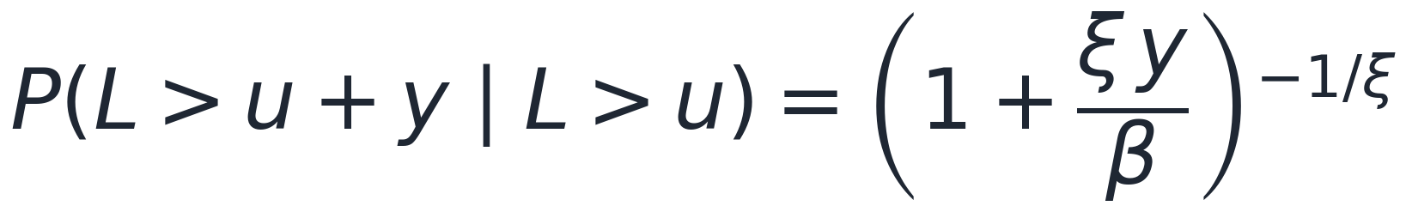
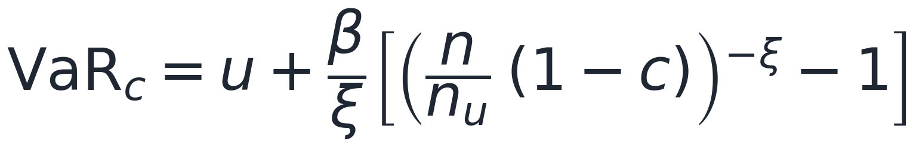
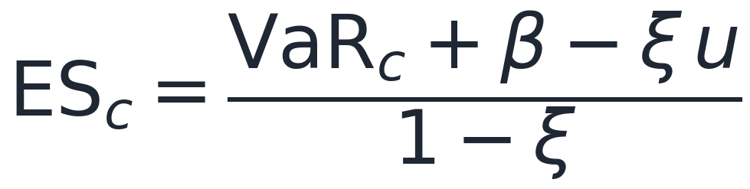
Extreme Value Theory and the Generalized Pareto
Peaks-over-threshold
Model only the tail: the distribution of losses beyond a high threshold u, not the whole distribution
The GPD is the limiting law of exceedances over a high u; fit the scale beta and shape xi by maximum likelihood
xi > 0 means fat tails (typical for equities, xi about 0.1 to 0.3)
Why it matters
Gives both VaR and ES at extreme confidence (e.g. 99.9%), more stable in the deep tail than empirical HS
Ties directly to the fat-tails discussion
The tail carries its own shape parameter xi - the key idea to remember
Notes:
EVT is the principled way to estimate the deep tail where you have few data points. Instead of assuming a full distribution, fit a Generalized Pareto to the exceedances over a high threshold u (e.g. the worst 5 to 10% of losses). This is what regulators and advanced desks use for 99.9% capital numbers. Keep it conceptual: scipy.stats.genpareto fits it in two lines; the takeaway is that the tail has its own shape parameter xi.
CLASSROOM EXAMPLE. Threshold u = 2%; over n = 1000 days, n_u = 50 exceed it; fitted GPD xi = 0.2, beta = 0.01. POT: given a loss past 2%, chance it also passes 3% is (1 + 0.2)^(-5) = 1.2^(-5) = 0.40. 99.9% VaR = 0.02 + (0.01/0.2)[(20 x 0.001)^(-0.2) - 1] = 0.02 + 0.05 x 1.19 = 7.9% = $79,400 on $1m. 99.9% ES = (0.0794 + 0.01 - 0.2 x 0.02)/0.8 = 10.7% = $106,700.
We model only the tail beyond 2%, which lets us reach a 1-in-1000 day historical simulation can never see.

Slide 34
Session Wrap-Up
Key takeaways
VaR(alpha, T) is the loss exceeded with probability (1 - alpha) over T days - a single quantile, not an expected loss
Three methods: parametric (fast, normal), historical simulation (non-parametric, backward-looking), Monte Carlo (flexible, model-dependent)
All three agree in calm markets and diverge under stress - that divergence is itself a model-risk signal
Component VaR splits portfolio risk into per-asset contributions; diversification benefit = sum of standalone minus portfolio VaR
VaR is not sub-additive and ignores tail severity - Basel FRTB replaces it with 97.5% Expected Shortfall
Assignment 1: implement all three methods plus component VaR on YOUR portfolio

